Slide 1
Kinematics Presentation Tom
3_27_25

Slide 2
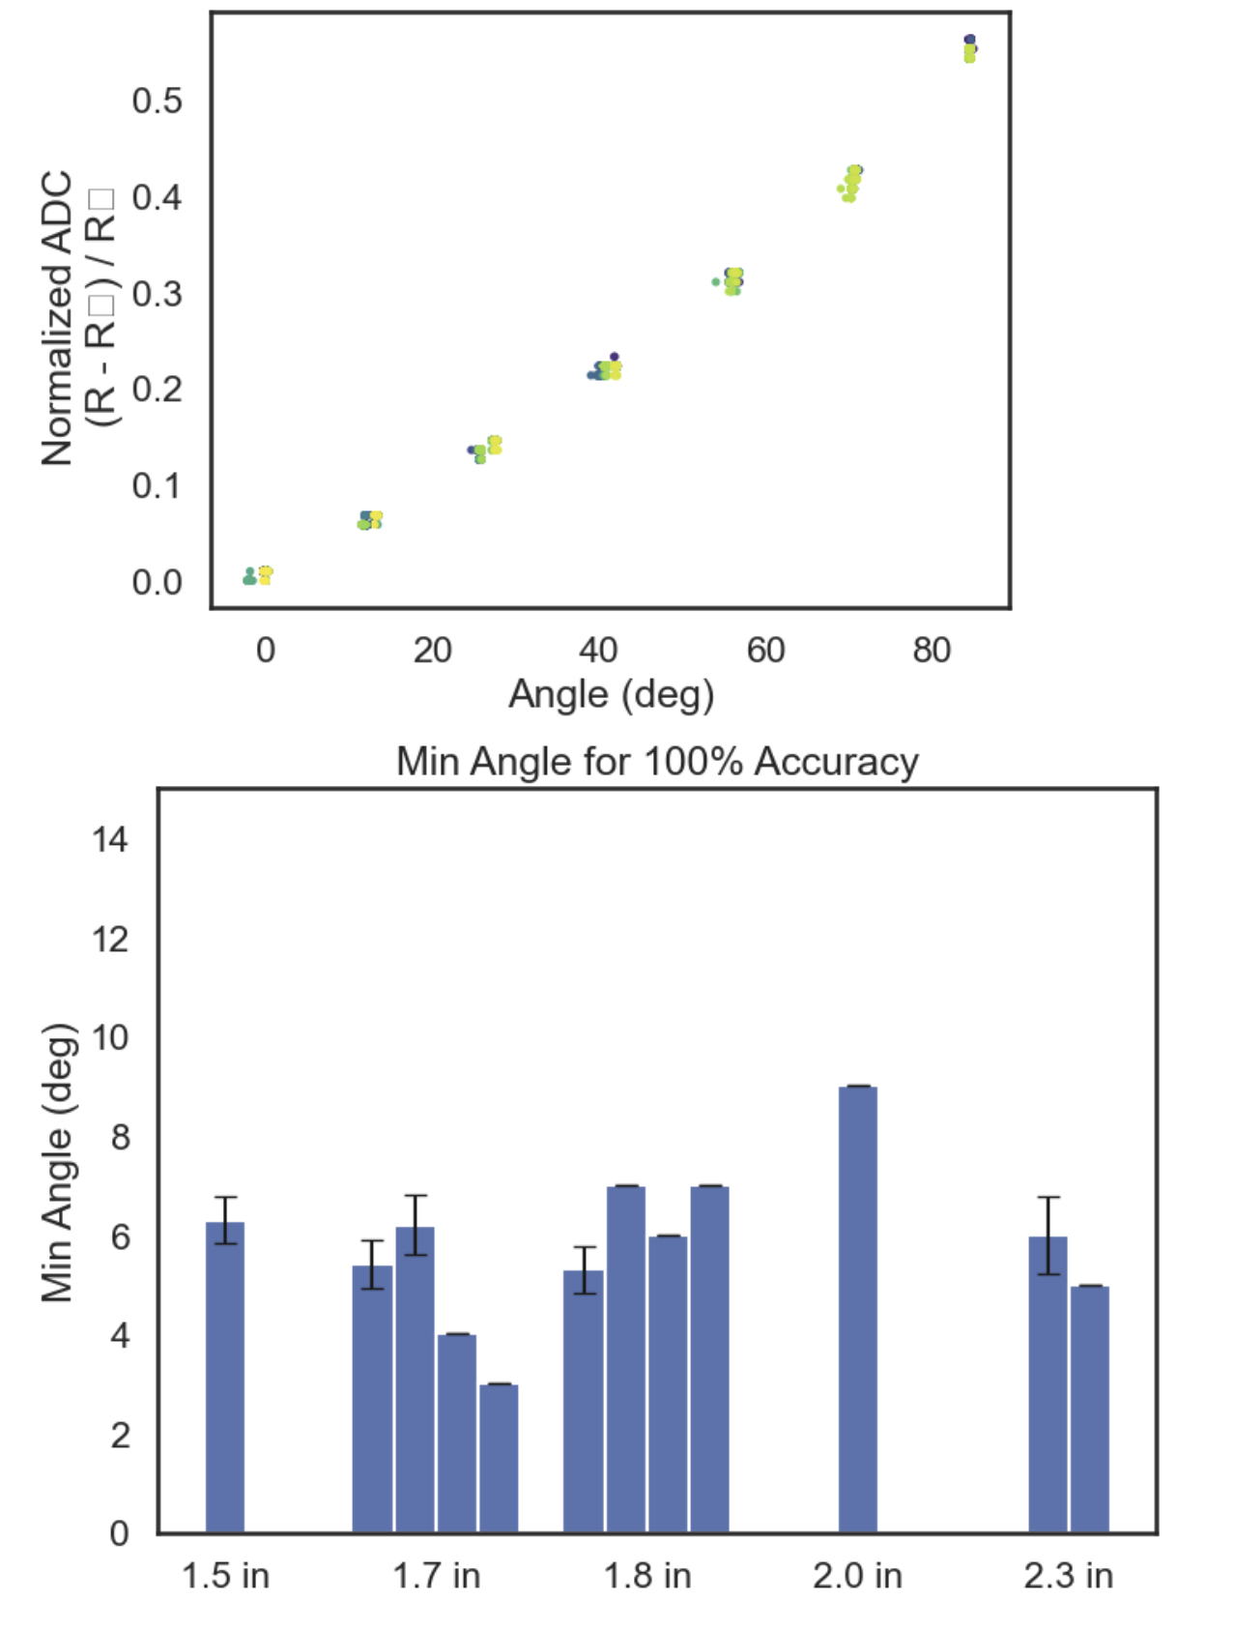
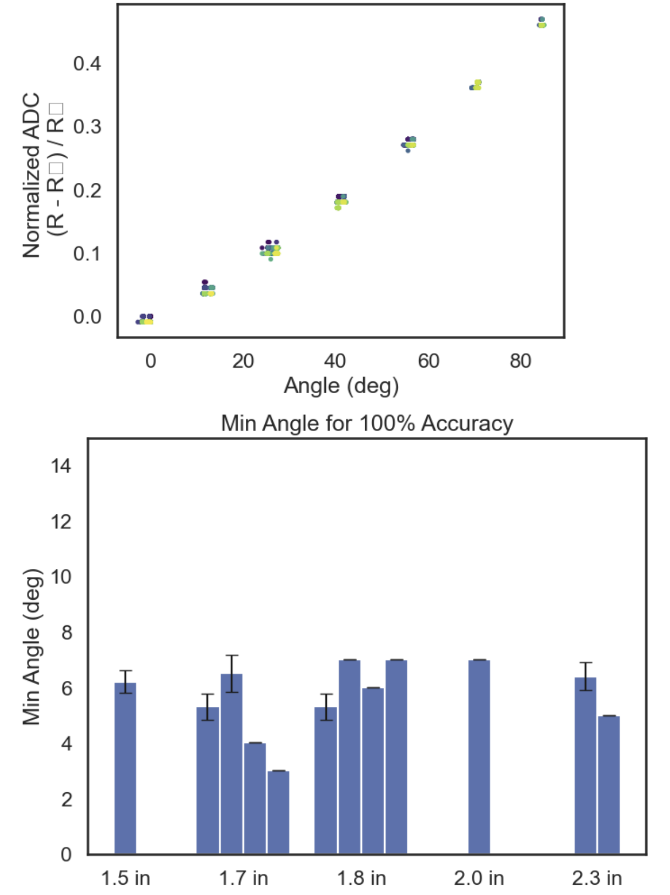
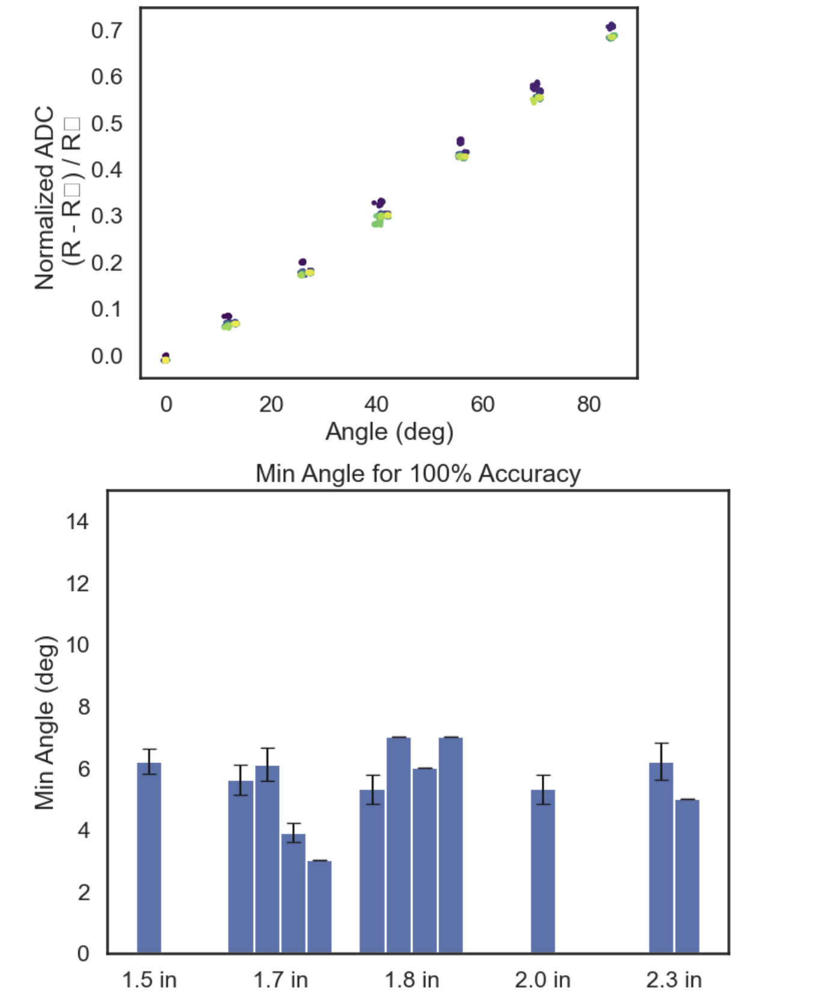
~0.67V source, 16 bit enc, 8x ADC gain, 100 ohm div
Just Re-testing previous
3.3V source, 16 bit enc, 8x ADC gain, 50 ohm div

Slide 3
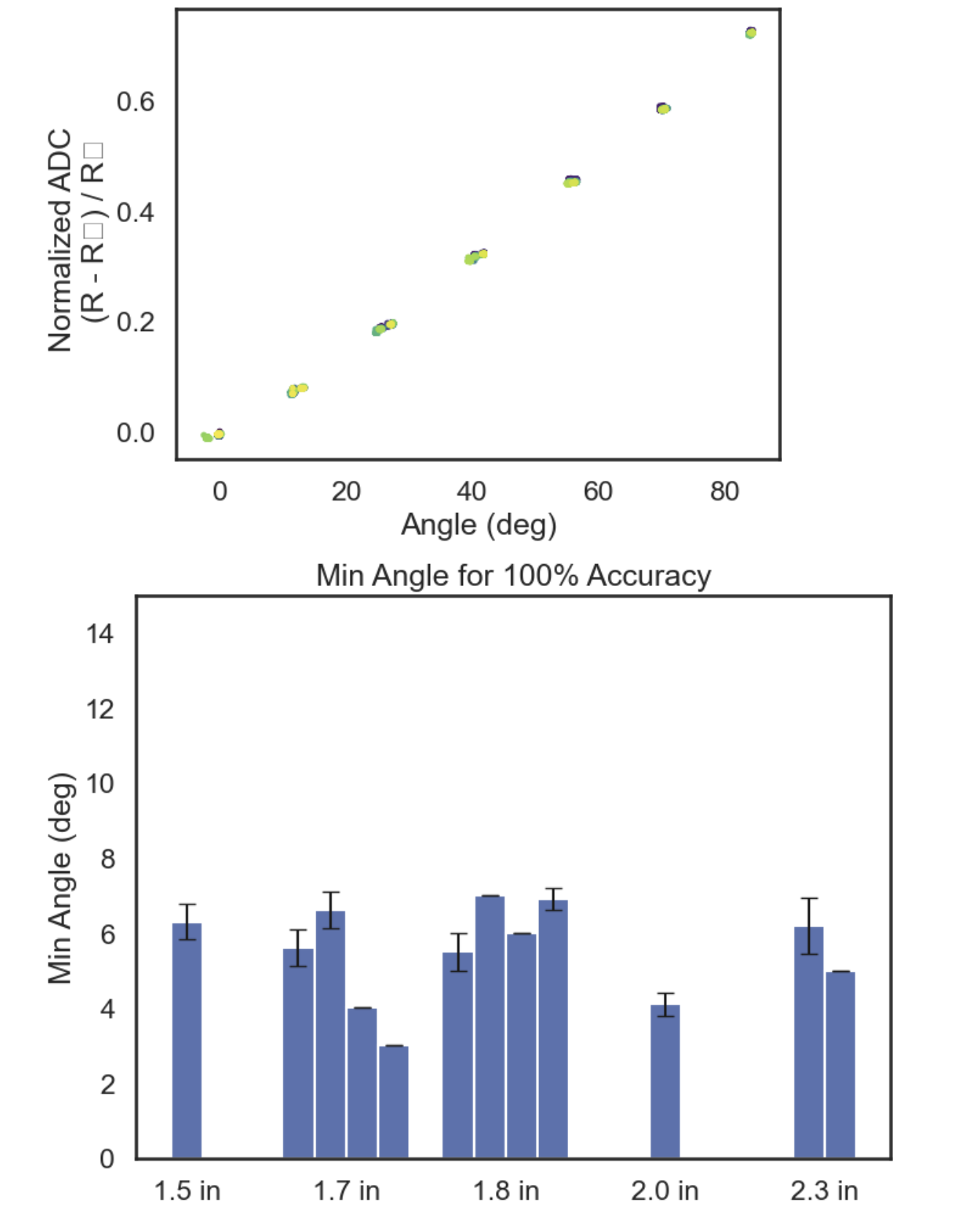
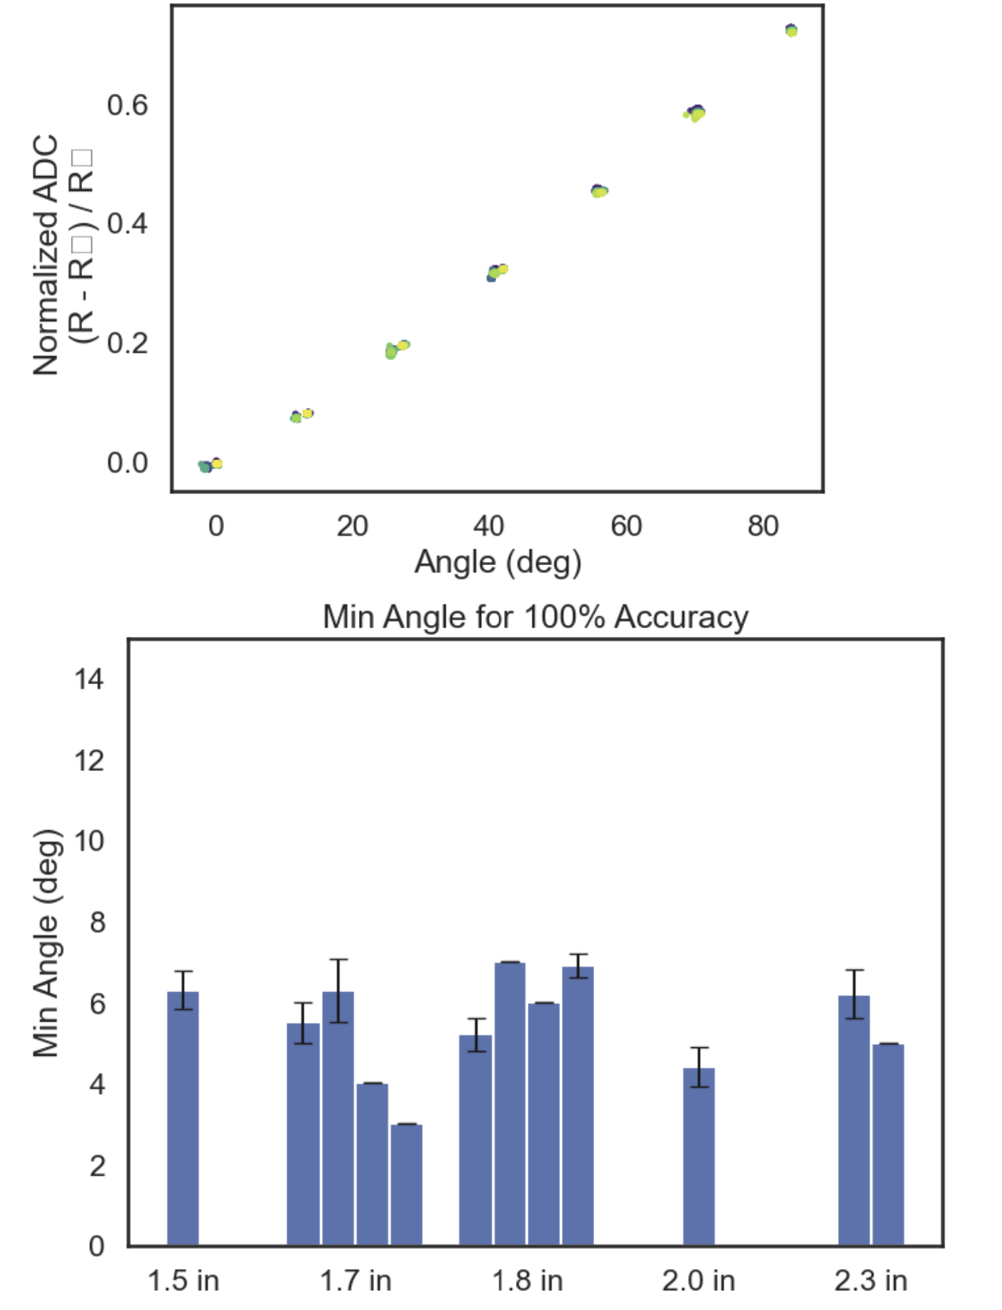
3.3V source from LVR and 2 x 10uF Caps, 16 bit enc, 8x ADC gain, 50 ohm div
3.3V source from LVR and 2 10uF Caps, 16 bit enc, 8x ADC gain, 40 ohm div (~15% of possible ADC range)
3.3V source, 16 bit enc, 8x ADC gain, 50 ohm div

Slide 4
Kinematics Presentation Tom
4_9_25

Slide 5
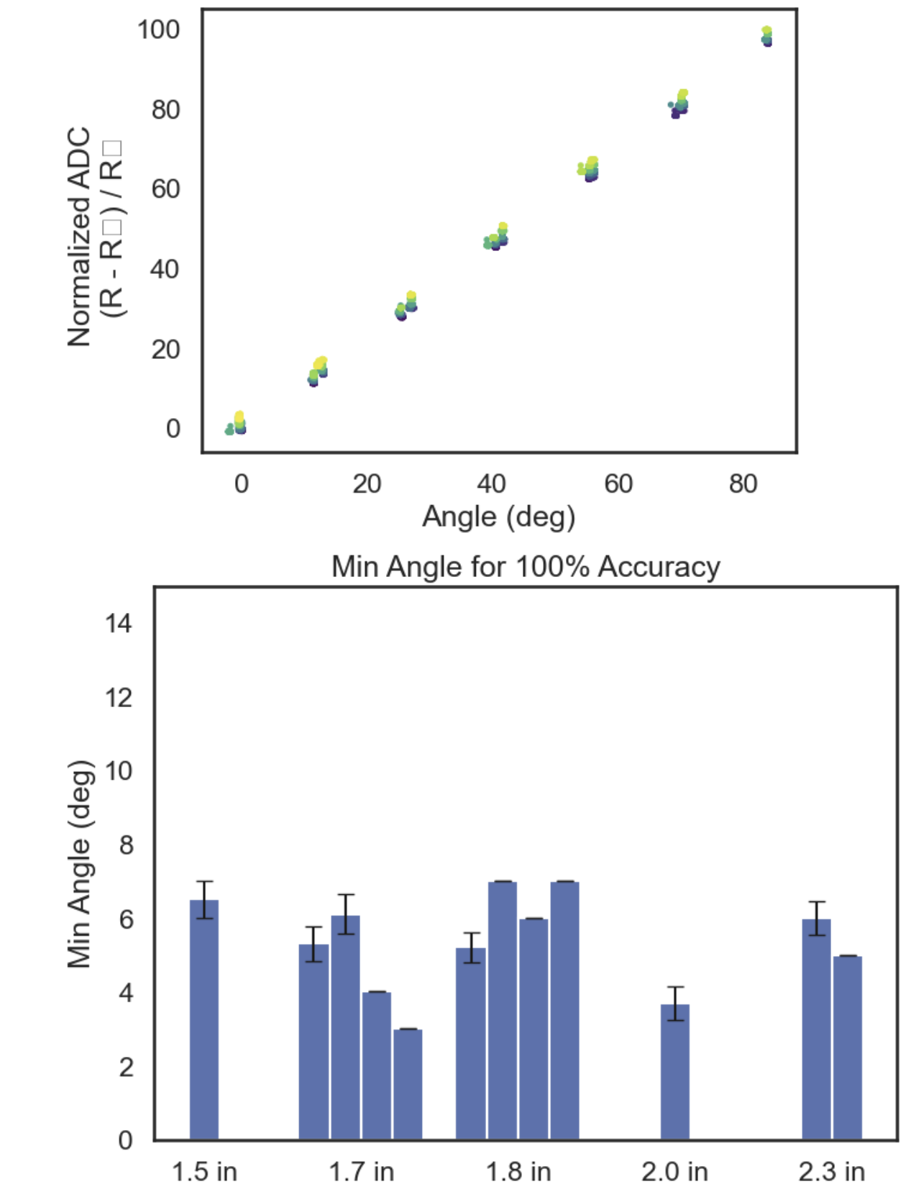
3.3V source from LVR and 2 x 10uF Caps, 16 bit enc, 8x ADC gain, 50 ohm div
3.3V source from LVR and 2 x 10uF Caps, 16 bit enc, 2x ADC gain (using diff input), 75x gain from LMC6482 (across gauge), 50 ohm div with 0.4 ohm strain gauge (see circuit)

Slide 6
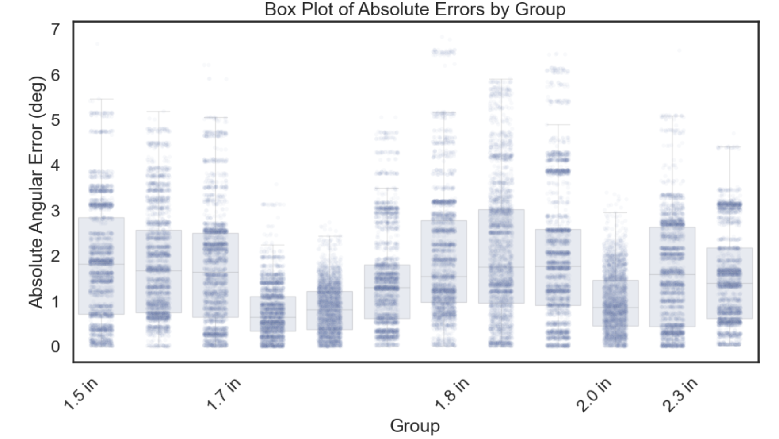

Slide 7
